Slide 1
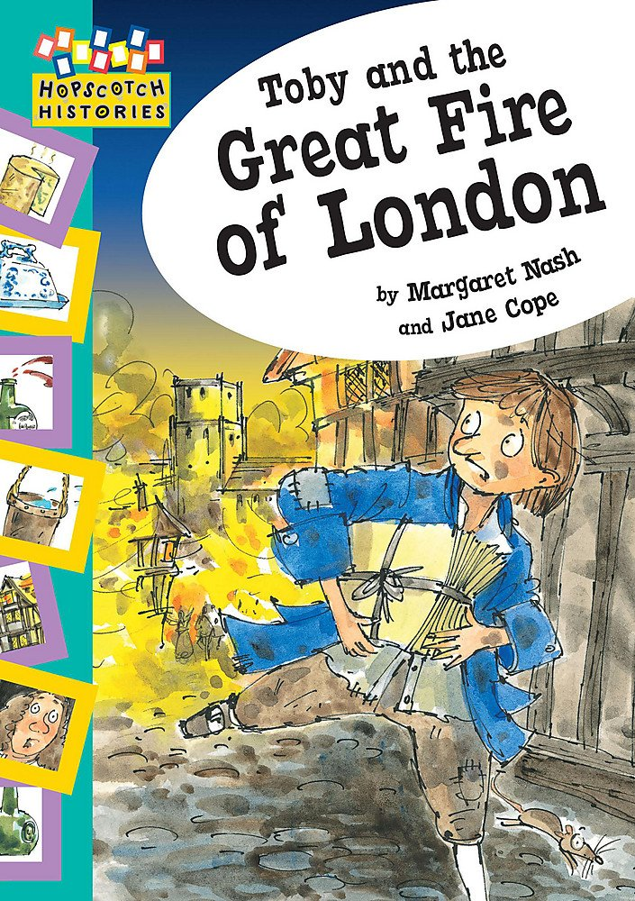
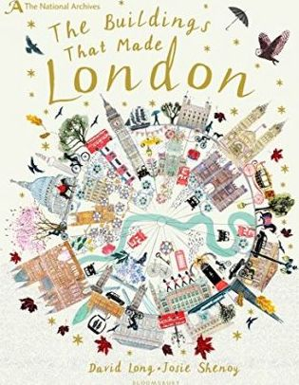
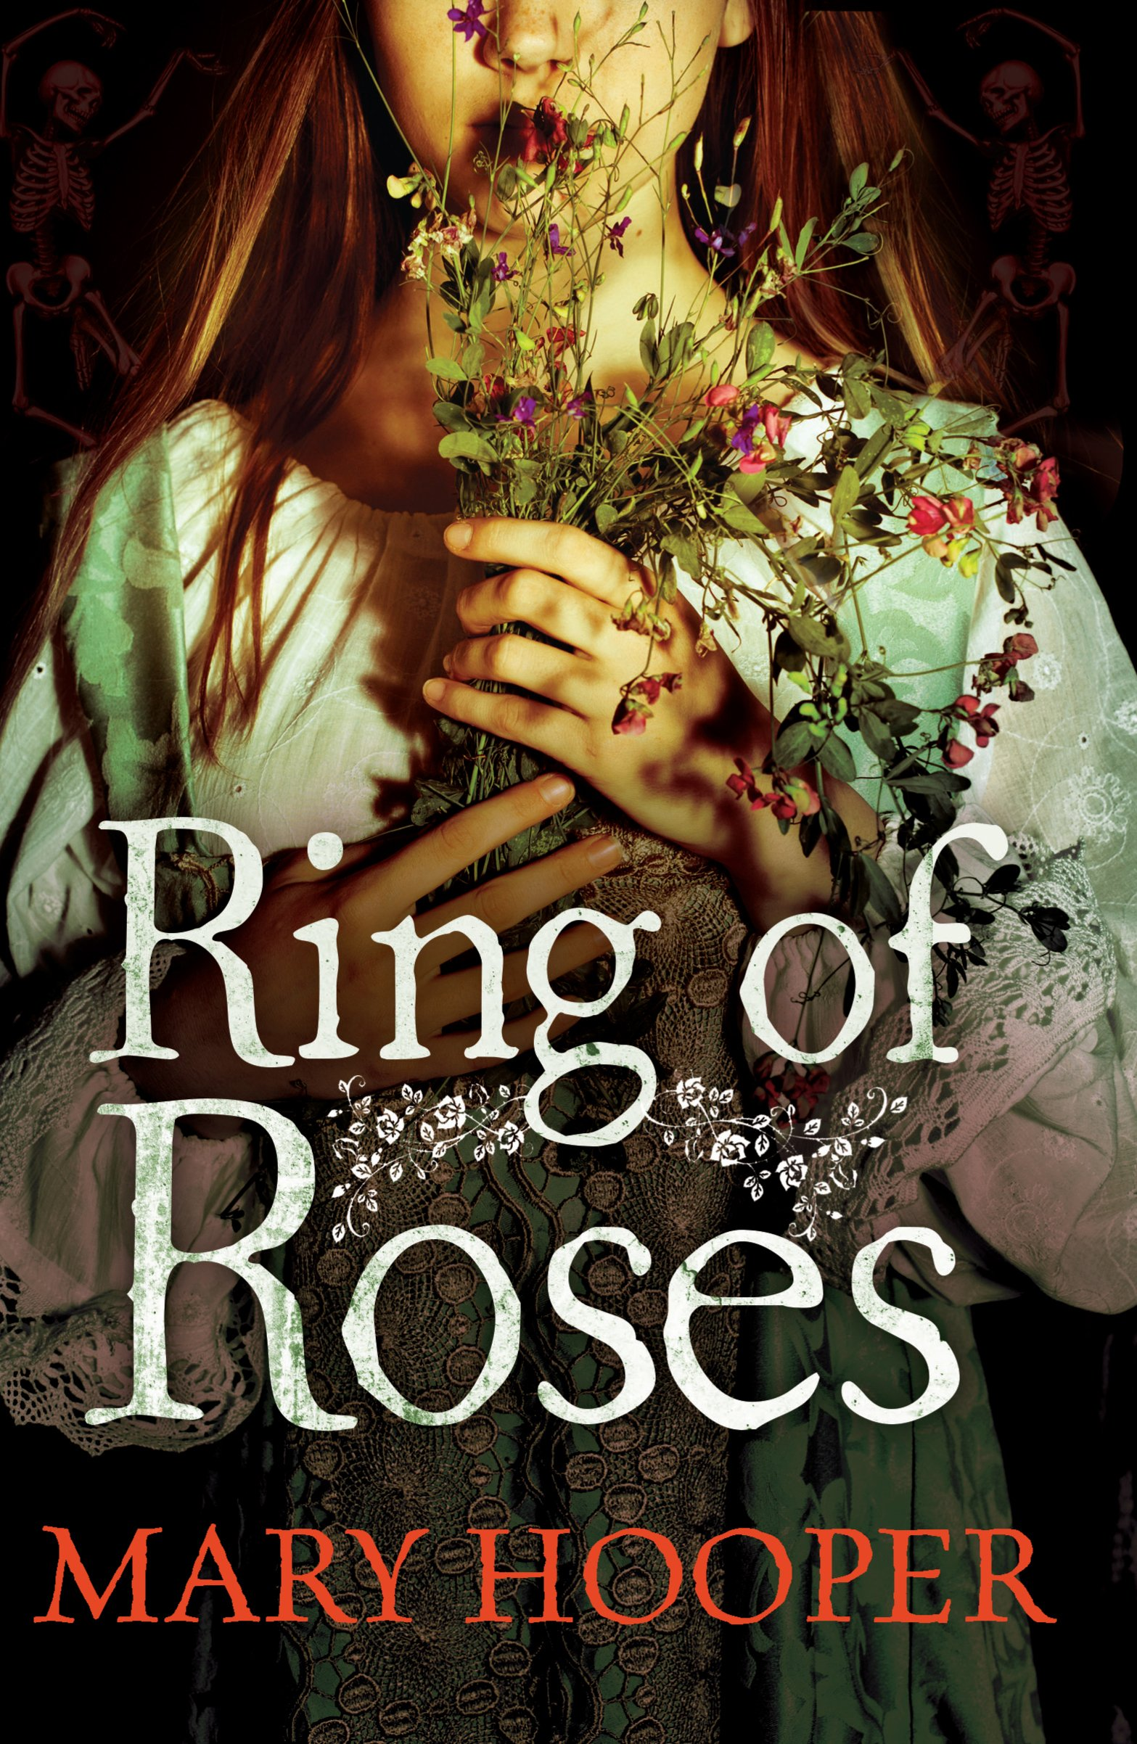
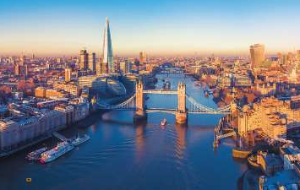
London Key Stage 1 Knowledge Mat
Subject Specific Vocabulary
Capital | A capital city (capital town or just capital) is a city or town, where the government sits.
Thames | The River Thames runs through London and is a major reason why London has grown to be a major city.
Buckingham Palace | This is the palace where the queen (or king) of the United Kingdom lives. When the queen is staying there, the flag flies.
Tower of London | The Tower of London, officially the queen’s Royal Palace and Fortress of the Tower of London, is a historic castle on the north bank of the River Thames in central London.
Houses of Parliament | This is where the people who run the country meet and discuss the main points they are making decisions about.
Underground | The London Underground is a world-famous transport system. It joins lots of stations with almost half of the route being underground.
The Shard | A reasonably new building that can be seen on London’s skyline from many places.
Union Jack | The Union Jack is the name of the flag of the United Kingdom.
Downing Street | Number 10 Downing Street is home to the Prime Minister of the country and number 11 Downing Street is the home of the Chancellor of the Exchequer (the person in charge of our money).
London Eye | A large circular wheel which was originally built for celebrating the year 2000 but has stayed to become one of London’s main attractions.
Sticky Knowledge about London
The Romans first settled in London 2000 year ago when it was called Londinium.
Since 1947, Norway has given London a Christmas tree as a sign of gratitude for the British help during the second world war.
London is the capital and largest city of England and the United Kingdom. 8.9 million people live in London.
For a long time, London was a small city. All its people lived inside the walls that were built by the Romans. This area is still called the City of London.
There were many villages around the city. Gradually, more people came to live there. Then, step by step, the villages joined together into one huge city.
The main river that runs through London is called the Thames. Because it is prone to flooding, the Thames Barrier was constructed.
Exciting Books
Key Knowledge
Know the names of all the four countries in the UK.
Know the names of all the capital cities for each of the four countries in the UK.
Name the three seas that surrounds the UK.
Identify where London is on a UK map.

