Slide 1
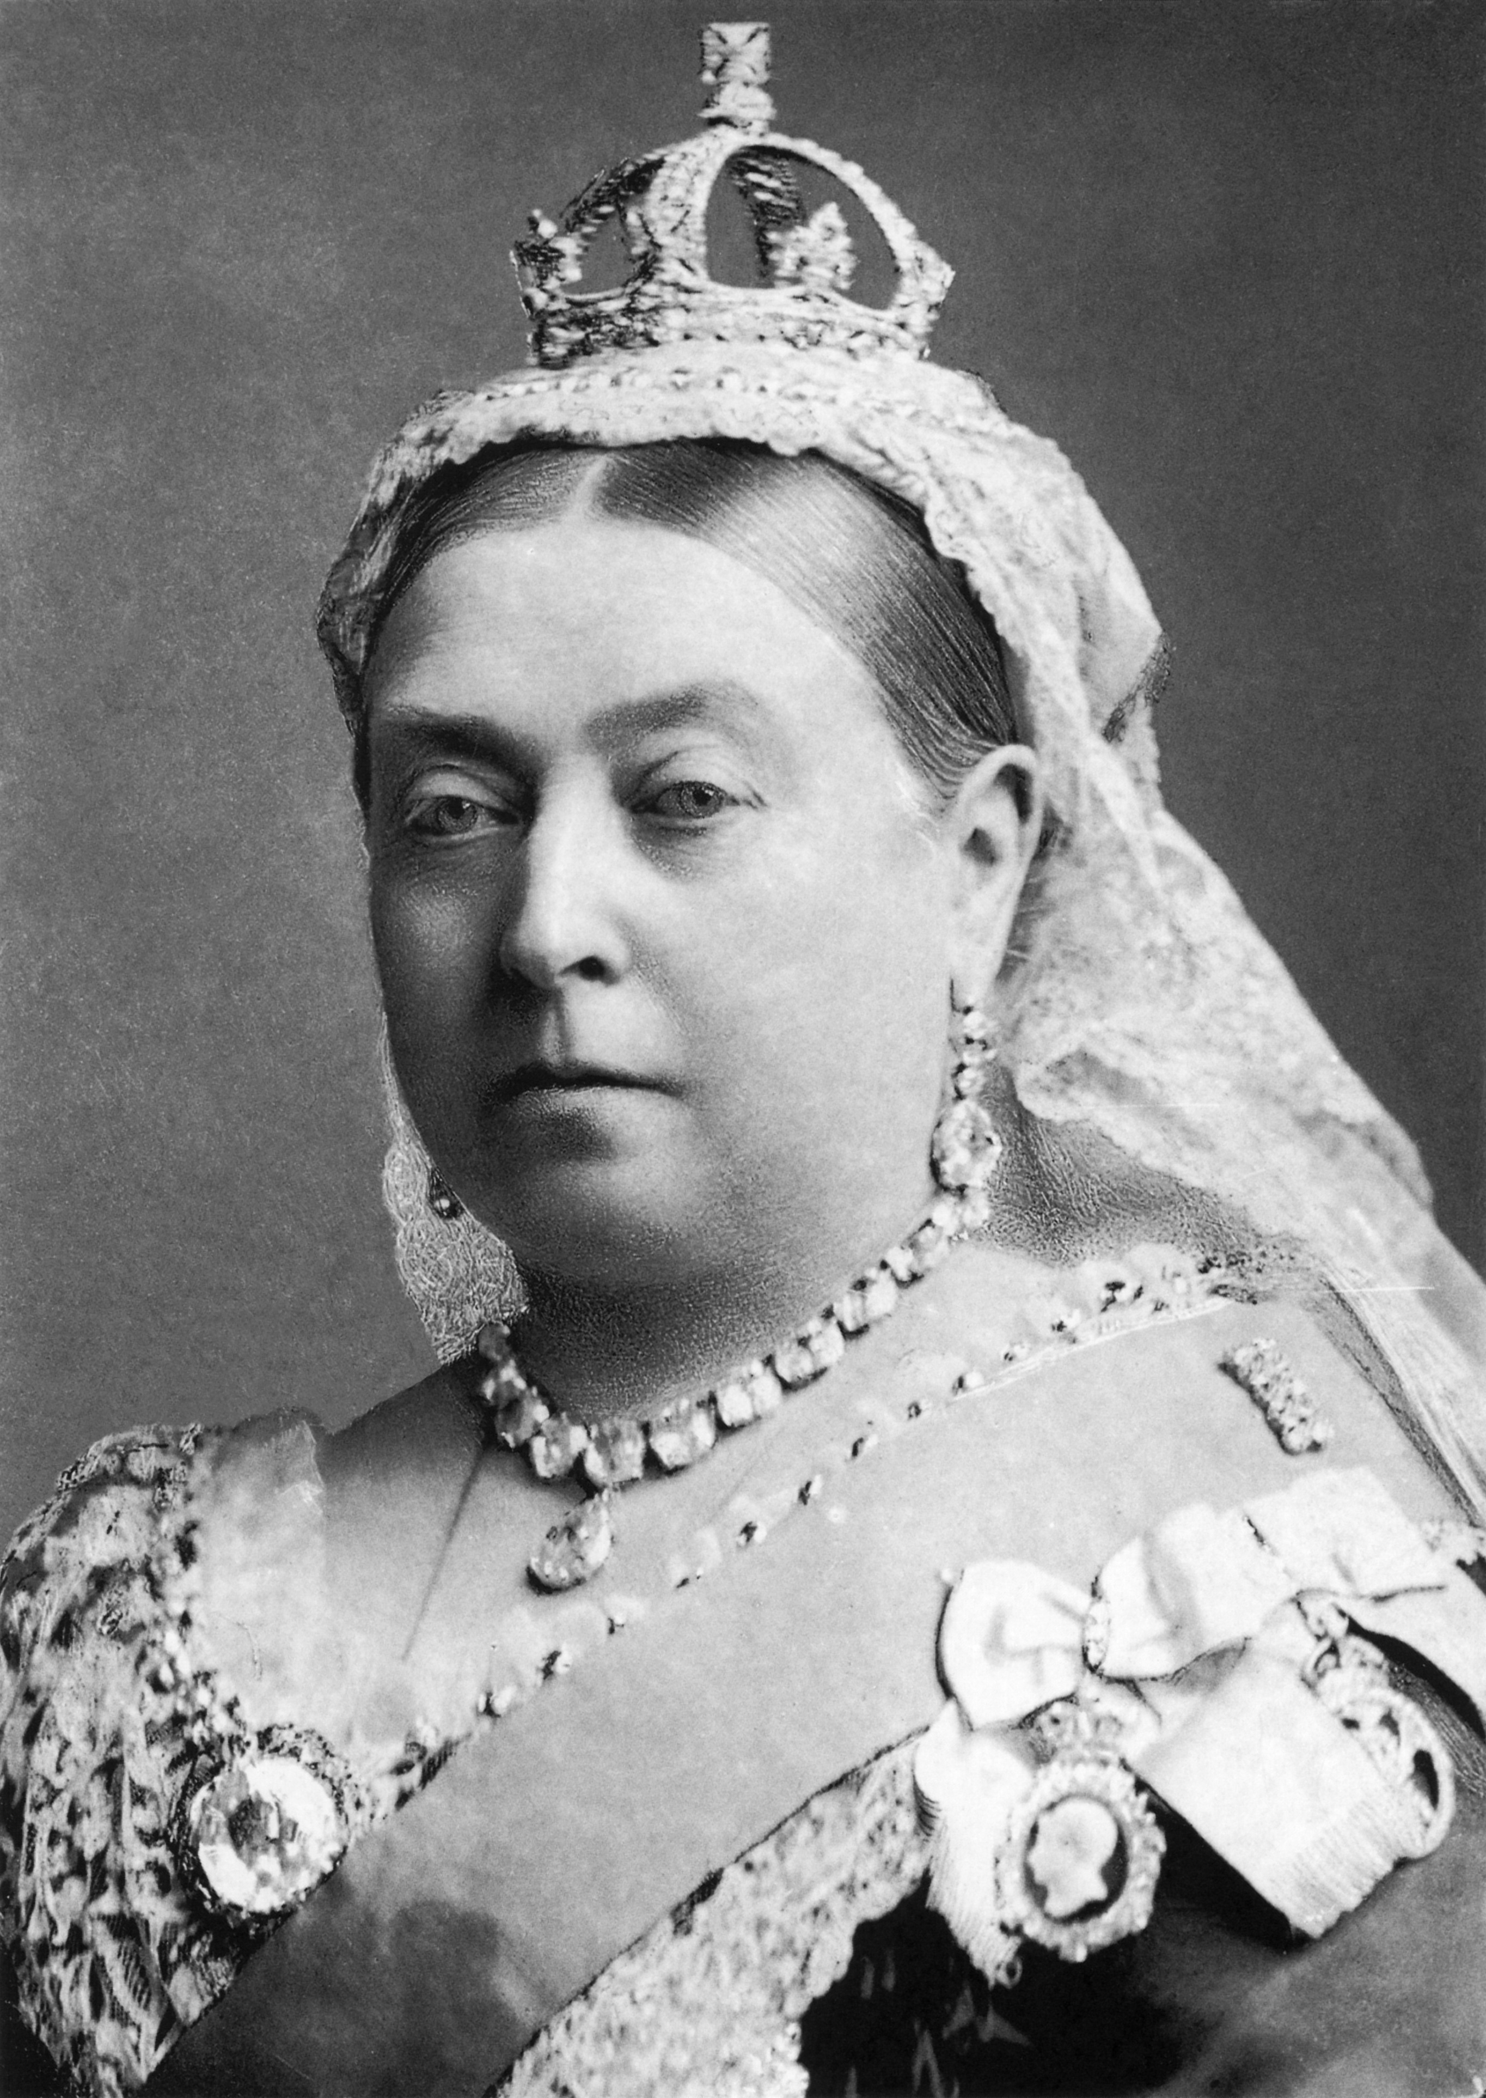
Beyond Living Memory: Year 2 Knowledge Mat
Subject Specific Vocabulary
gramophone | A gramophone is an old type of record player. A gramophone plays records.
wireless | The earliest form of radios. The word radio replaced wireless around the 1920s.
quilt | A quilt is the name given to a warm and heavy covering put on a bed. Today we use a duvet.
penny farthing | This was one of the earliest bicycles. It had one large and one small wheel.
farthing | A farthing was a coin. It was a quarter of an old penny. Four farthings made an old penny.
washing dolly | A washing dolly was historically a tool used for tossing laundry by pumping the dolly up and down on the laundry in the dolly tub.
charabanc | A type of horse-drawn vehicle or early motor coach, usually open-topped.
workhouse | This was the home to many orphaned or sick children. It was also home to poor people without a job.
gruel | Gruel is a food consisting of some type of cereal – oat, wheat or rye flour, or rice – boiled in water or milk.
Prior Knowledge
There is an expectation that most children will appreciate that lives of children were different in the past. The toys that children would have played with were different as was the food they ate
They transport used was different to what we use today.
 | Queen Victoria was queen of the United Kingdom and Ireland for 64 years and that period of time was known as the Victorian period.
Exciting Books
Key Knowledge and Skills
Know about an event or events that happened long ago, even before their grandparents were born
Know what we use today instead of a number of older given artefacts
Know that children’s lives today are different to those of children a long time ago
Older dates from earliest to latest on simple timelines
Sequence pictures from different periods
Look carefully at pictures and objects to find information
Use words and phrases such as: old, new, earliest, latest, past, present, future, century, new, newest, old, oldest, modern, before, after to show the passing of time
Find answers and respond to simple questions about the past
Choose and select evidence and say how it can be used to find out about the past

