Slide 1
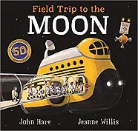
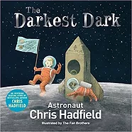
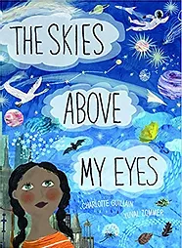
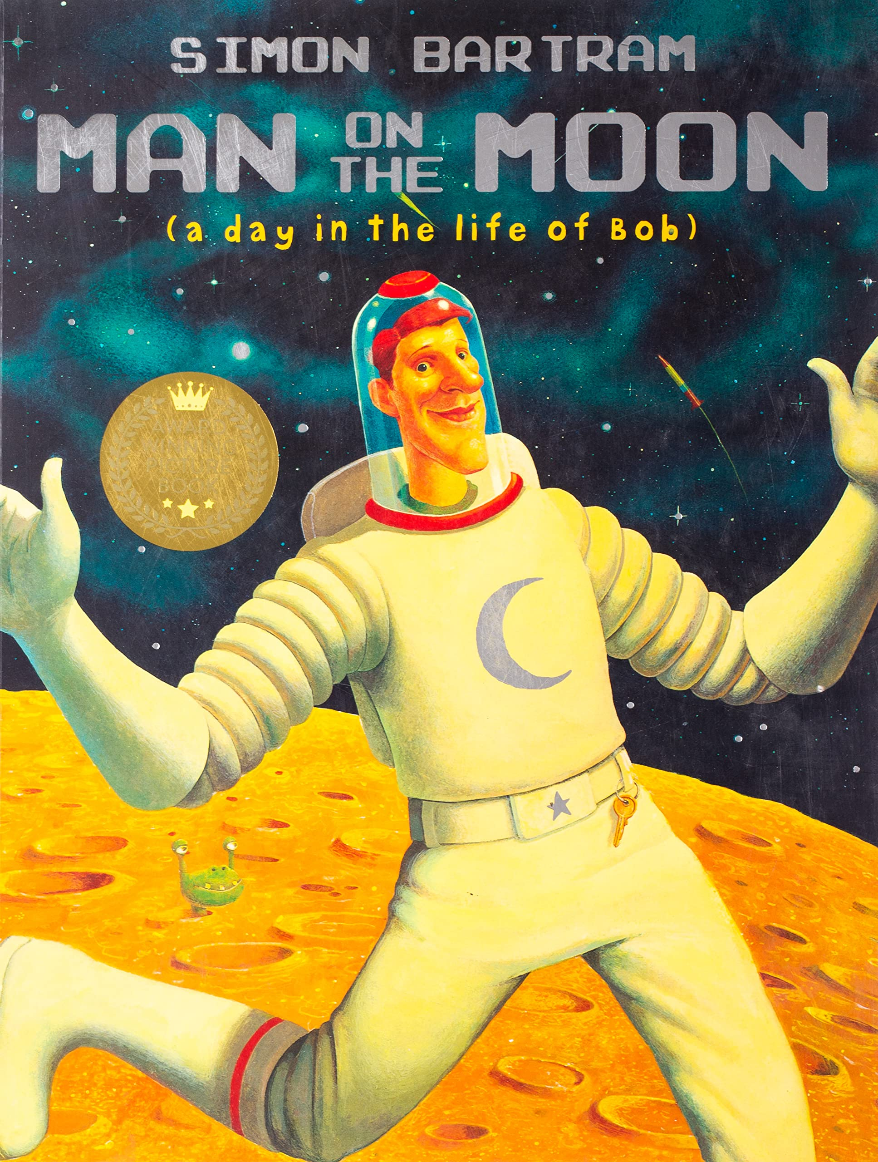
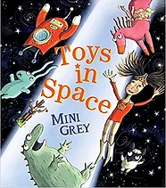
The history of space travel knowledge mat
Space Travel
orbit | A path followed by an object such as a spacecraft or planet as it moves around a planet or star.
atmosphere | The air that surrounds and protects the Earth.
Space Race | The ‘Space Race’ was the name given to the competition between the USA and the Soviet Union to put the first man in space. The end goal was to land on the Moon.
rocket | A rocket may be a missile, spacecraft, aircraft or other vehicle which is pushed by a rocket engine.
re-entry | Re-entry is used to refer to the moment when a spacecraft comes back into the Earth’s atmosphere after being in space.
mission | A journey, by a manned or unmanned vehicle, into space for a specific reason.
launch | Start or set in motion a vehicle, usually a rocket, into space.
astronaut | A person who is trained to travel in a spacecraft.
satellite | A satellite is an object that has been sent into space to collect information.
Milky Way | It is made up of over 200 billion stars. It is around 13.6 billion years old. It is home to our solar system.
optical | The word optical means things to do with seeing. Can you think of another word that starts in the way as optical?
telescope | A telescope is an optical instrument which makes things far away seem nearer.
Prior Knowledge Expectations
Pupils should know that the Moon appears a different shape within each month.
Pupils should know that man has landed on the Moon.
Pupils should know that the Sun is star and that the Earth is part of the sun’s solar system.
Sticky Knowledge about famous space people:
Neil Armstrong was the first person to step foot on the Moon. It happened on July 20th 1969.
Galileo made some amazing discoveries using his telescope: The Moon does not have a smooth surface. Venus orbits the Sun. Jupiter has moons orbiting it. The Earth is not at the centre of the solar system. The Milky Way is not just a band of light in the sky.
Katherine Johnson – was an American mathematician. Her work helped to send astronauts to the Moon.
Exciting Books
Key Knowledge and Skills
Name a famous person/s from the past and explain why they are famous
Recall a famous event from the past and explain why it is significant
Order dates from earliest to latest on simple timelines
Recount historic details from eye-witness accounts, photos and artefacts

