Slide 1
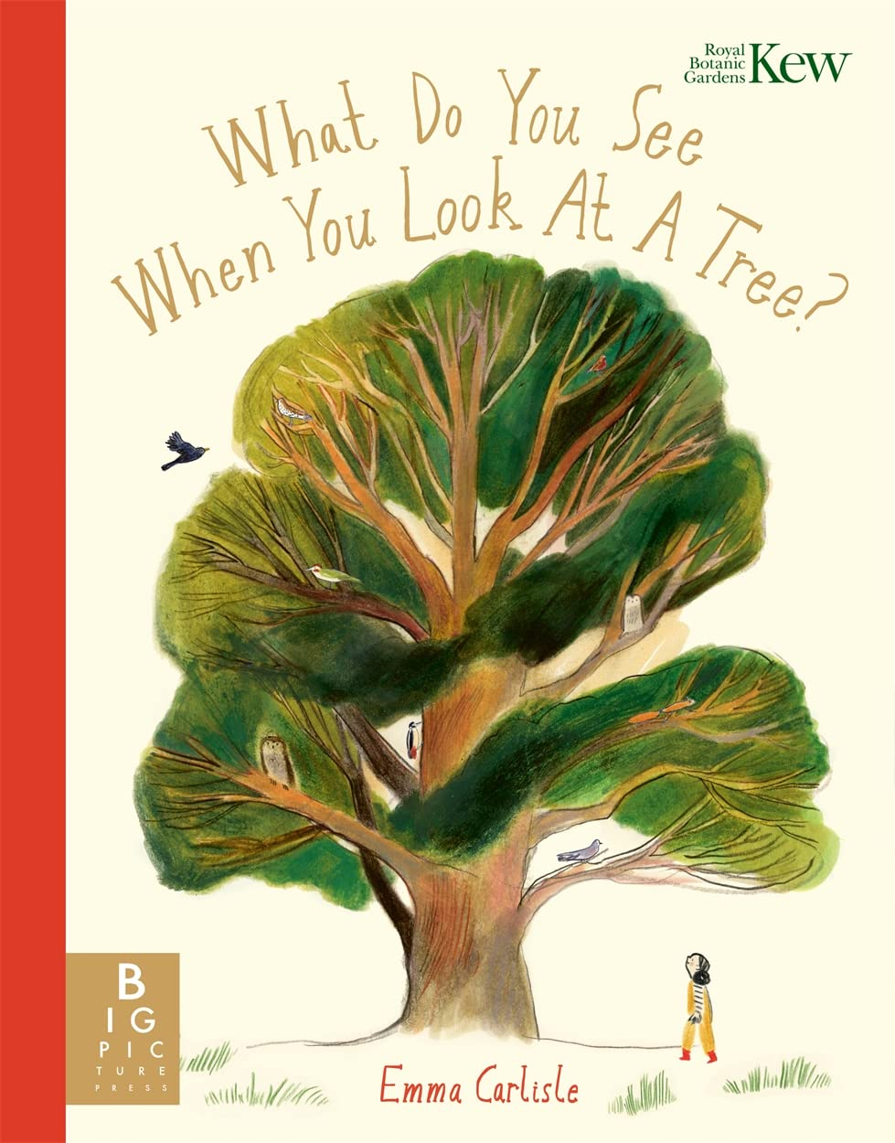
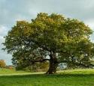
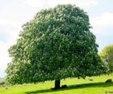
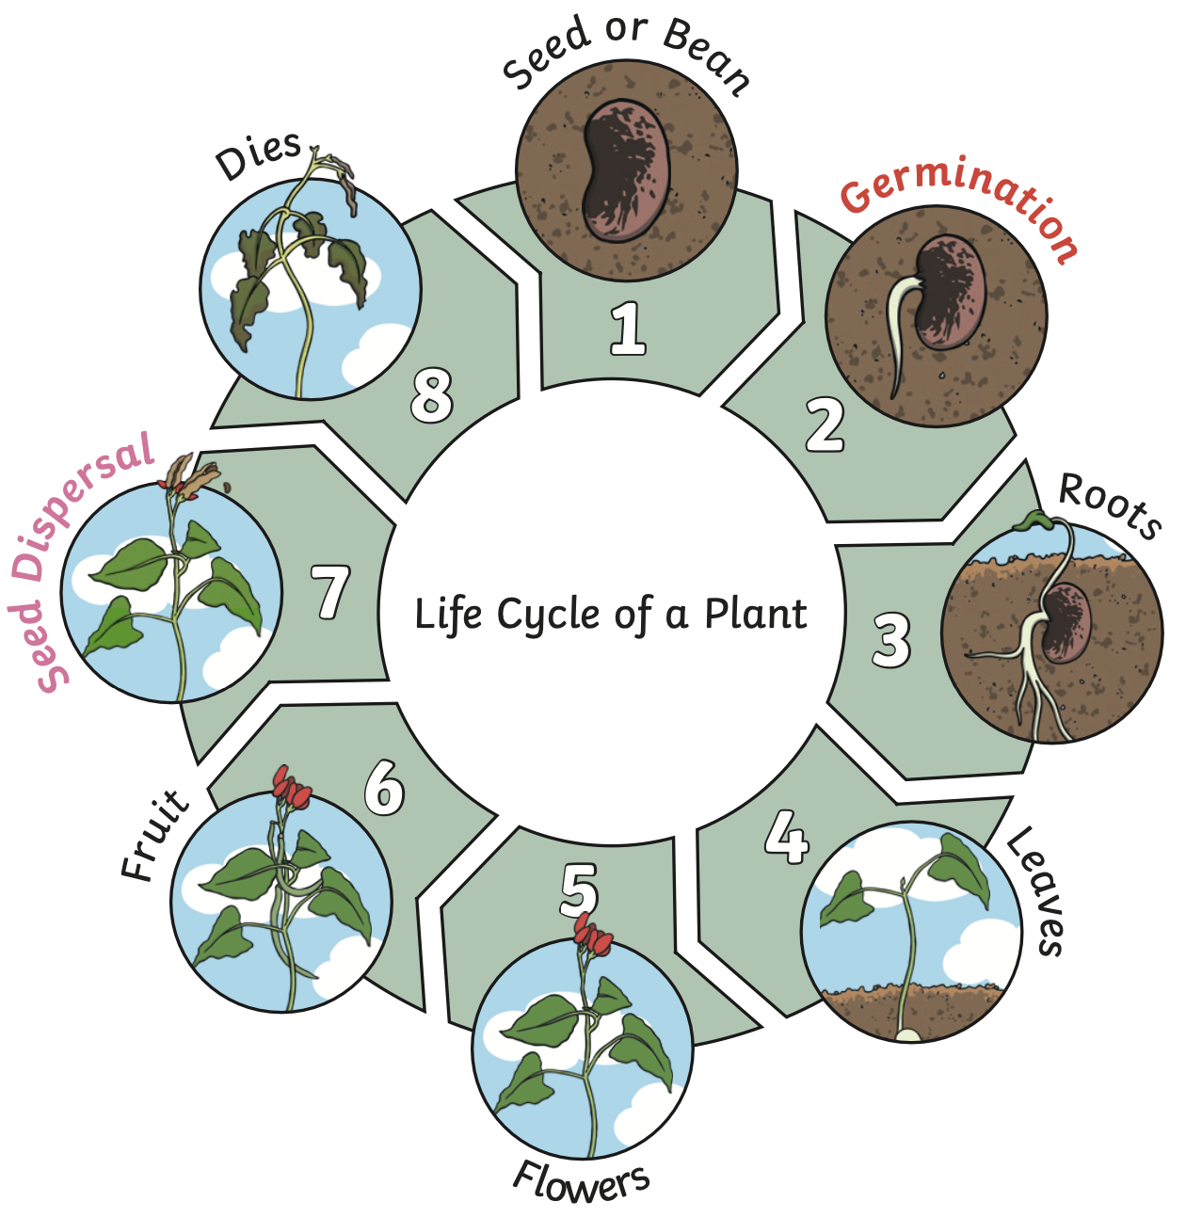
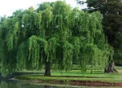
Year 2: Plants and Trees Knowledge Mat
Subject Specific Vocabulary |  | Interesting Books | Sticky Knowledge about trees
roots | The roots are part of a plant that is usually hidden under the ground. They make the plant stable and give it nutrients.
 |  |  | Trees and shrubs take in water and carbon dioxide and give out oxygen.
crown | The crown is made up of the leaves and branches at the top of the tree.
 |  |  | Trees can live for a very long time. The oldest known tree is over 5000 years old.
deciduous | Deciduous trees are trees that shed their leaves in the autumn and grow new leaves in the spring. |  | Trees can live for a very long time. The oldest known tree is over 5000 years old.
 |  | Common trees found in the UK | A single tree has many roots. The roots carry food and water from the ground through the trunk and branches to the leaves of the tree.
evergreen | Evergreen trees are the same as coniferous trees. They do not lose their leaves in autumn.
germination | When the conditions are right, the seed soaks up water and swells, and the tiny new plant bursts out of its shell. This is called germination.
germination | When the conditions are right, the seed soaks up water and swells, and the tiny new plant bursts out of its shell. This is called germination. |  | The trunk is the main body of the tree. The trunk is covered with bark which protects it from damage.
bulb | Bulbs are underground masses of food storage from which plants grow.
bulb | Bulbs are underground masses of food storage from which plants grow. |  | The leaves can be of many different shapes. They take in sunlight and use water and food from the roots to make the tree grow.
shoot | A shoot grows upwards from the seed or plant to find sunlight.
trunk | A tree's trunk holds up its crown, protects its inner parts and works like a pipeline, transporting essential materials to the different parts of the tree.
trunk | A tree's trunk holds up its crown, protects its inner parts and works like a pipeline, transporting essential materials to the different parts of the tree.
stem | The stem is the main part of the plant. It supports the weight of the leaves, as well as the flowers or fruit.
woodland | A woodland is a habitat where trees grow.
habitat | The place where a plant or animal (mostly) lives. There are different kinds of habitats, such as grassland, forest, river, sea and desert. |  | As a tree grows, it usually produces growth rings as new wood is laid down around the old wood.
oak
horse chestnut
conifer
willow

