Slide 1
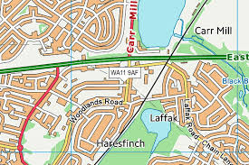
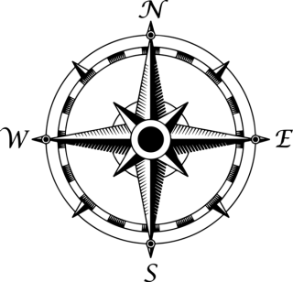
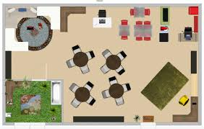
Mapping Year 2 Knowledge Mat
Subject Specific Vocabulary
south | The southern part of the world or of a specified county, region, or town.
north | The northern part of the world or of a specified county, region, or town.
east | The eastern part of the world or of a specified county, region, or town.
west | The western part of the world or of a specified county, region, or town.
map | A diagrammatic representation of an area of land or sea showing physical features, cities, roads, etc.
route | A way or course taken in getting from a starting point to a destination.
map symbol | A picture used to show a feature on a map, such as church or school.
map key | A system or list for telling you what the symbols stand for.
compass | An instrument containing a magnetised pointer which shows the direction of magnetic north.
aerial | A picture taken from directly above, for example from a drone or plane.
landmark | An object of a landscape that is easily recognised.
Exciting Books
Countries and capital cities of the UK
England – London
Scotland – Edinburgh
Wales – Cardiff
Northern Ireland - Belfast
Key knowledge and skills
Use world maps, atlases and globes to identify the UK and its countries, as well as the continents and oceans covered at this stage.
Use simple fieldwork and observational skills to study the geography of their school and its grounds and the key human and physical of its surrounding environment.
Use aerial photographs and plan perspectives to recognize landmarks and basic human/physical features; devise a simple map and sue and construct basic symbols in a key.
Use simple compass directions (NESW) and locational and directional language (near/far/left/right) to describe the location of features and routes on a map.

